Slide 1


Sustainability
Outreach
Notes:
April is the month Nativity focuses on Sustainability Outreach.

Slide 2
Nurturing Our Resources
Reducing Our Footprint
Caring for Creation
Reducing Our Runoff
Reducing Our Waste
Notes:
It is a time we celebrate the many things Nativity has done to care for creation.

Slide 3
Nurturing Our Resources
Notes:
We celebrate the work Nativity is doing to nurture the natural world we share our space with.

Slide 4
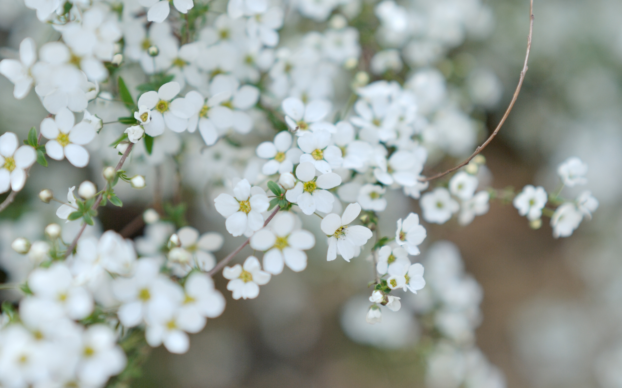
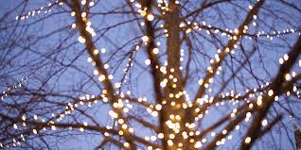
Notes:
Trees play an important role in Nativities outreach, inviting the community to celebrate God’s creation with us. Apple blossoms herald the new life of Spring, and Christmas lights rejoice in the new life of Jesus’ birth.

Slide 5
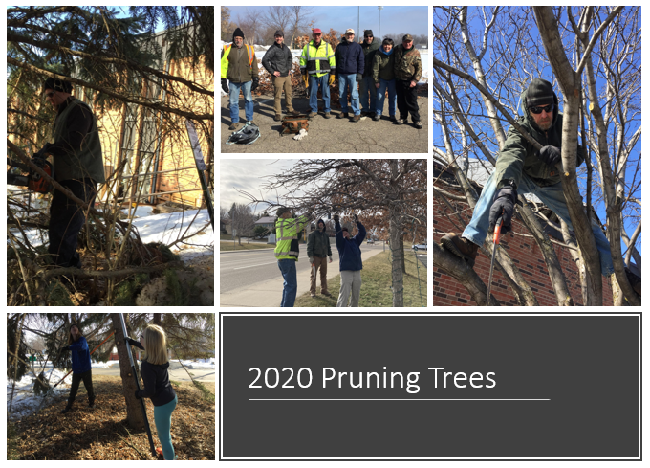
Pruning Trees
Notes:
We are blessed with a community of experts and friends who help us care for our trees.

Slide 6
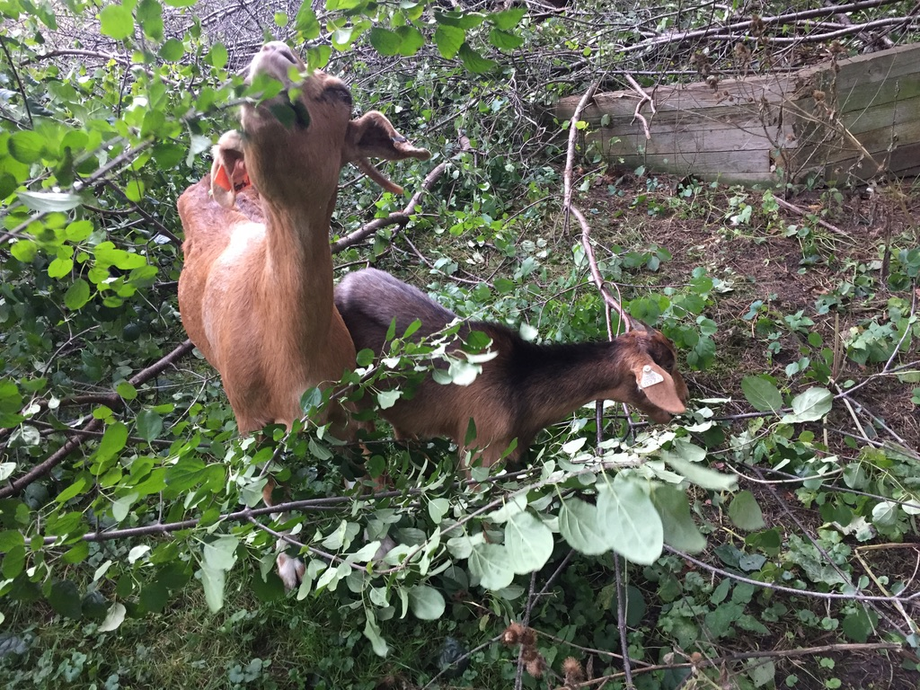
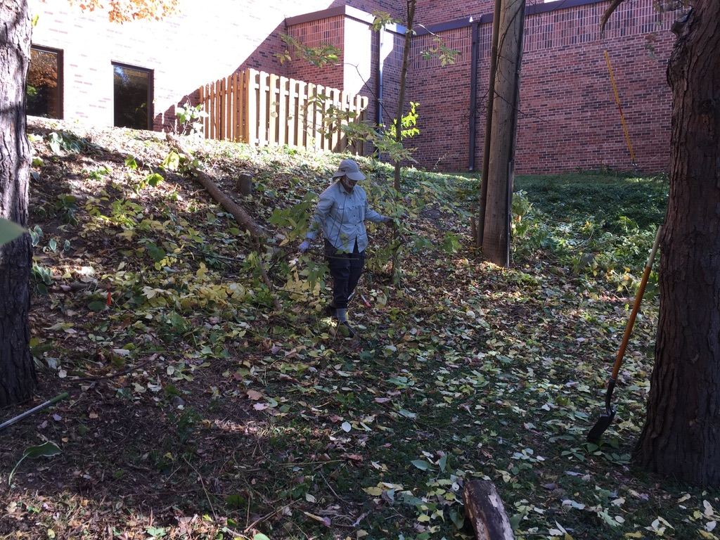
Clearing Out Buckthorn
Notes:
Friends of another nature started us on our way to clearing out invasive buckthorn on the West side of church. Last Fall a group of volunteers started the work of clearing out overgrown brush and trees.

Slide 7
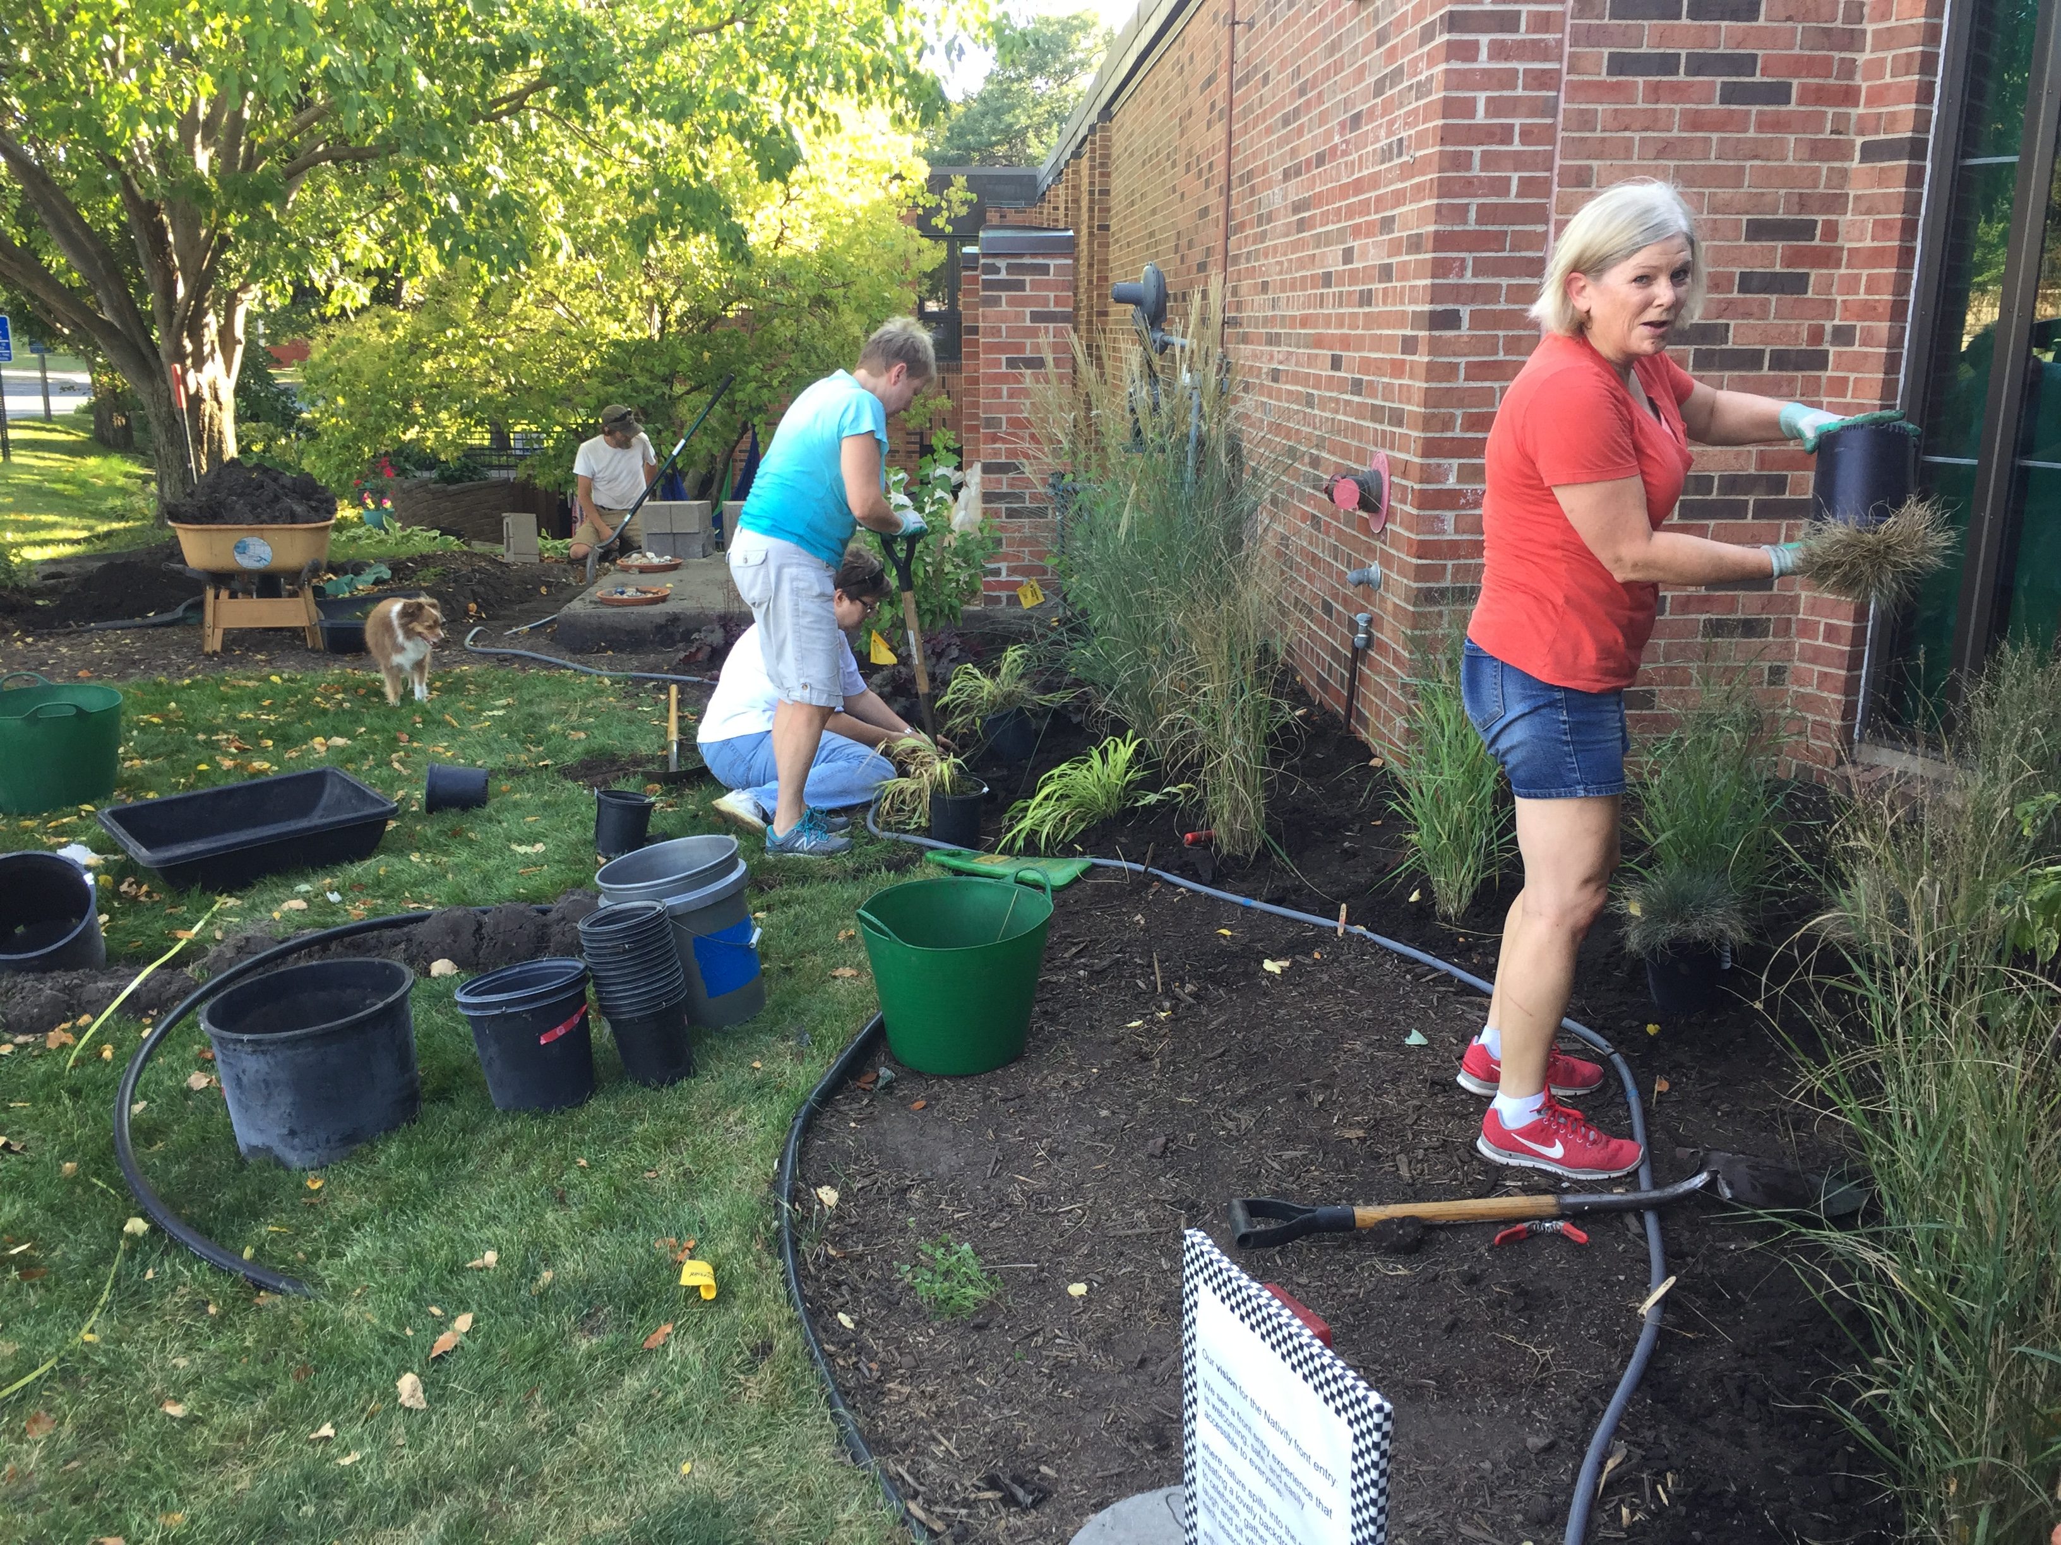
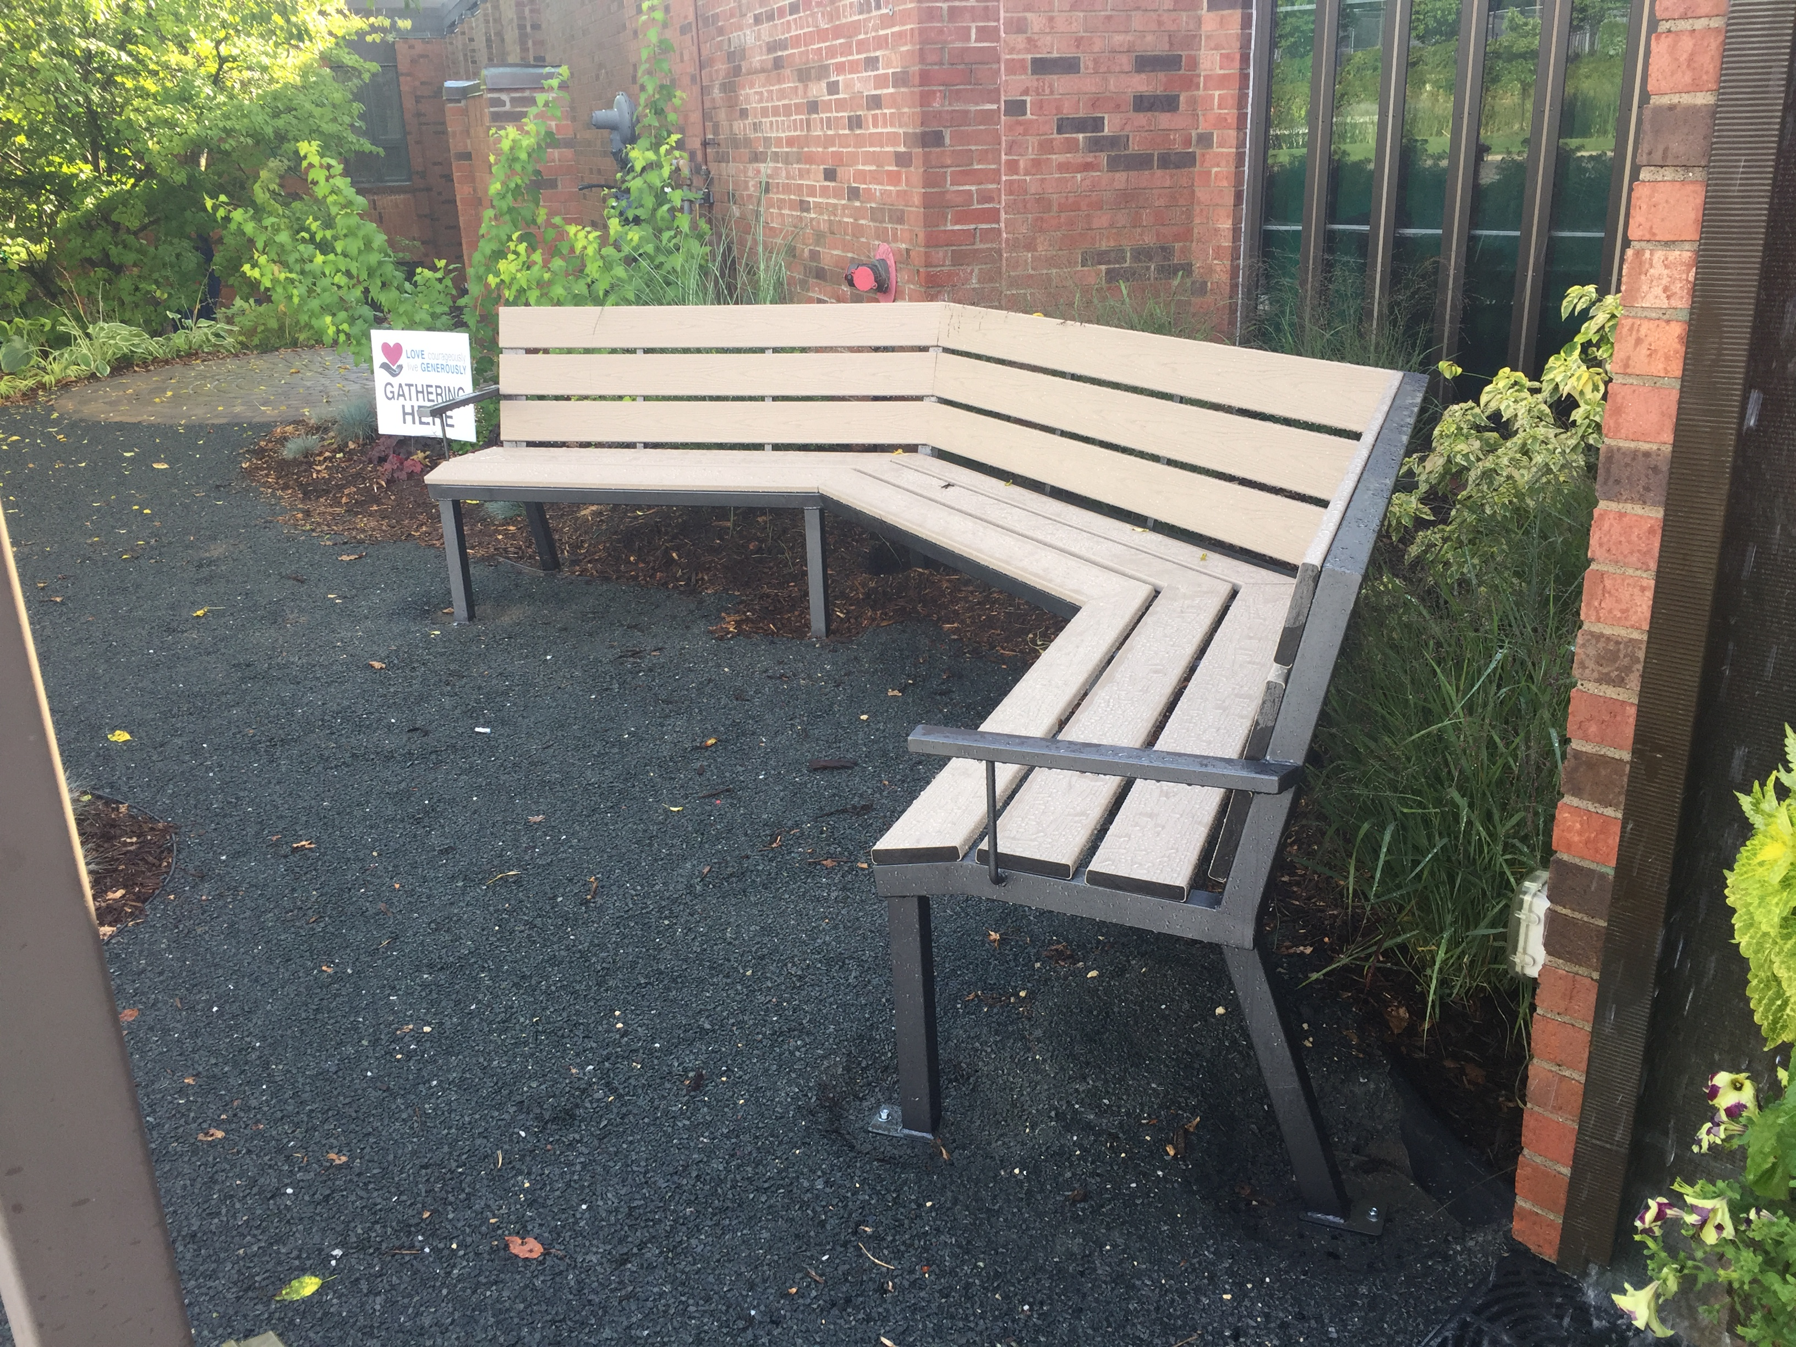
Transitioning green spaces to reduce water usage
Notes:
We redesigned the front entrance plantings to reduce the amount of water we use to maintain our green spaces.

Slide 8
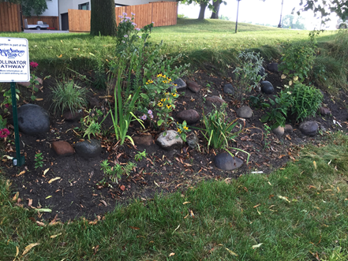
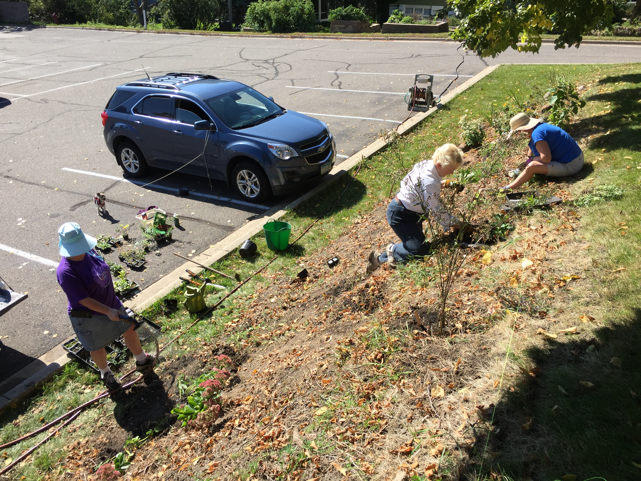
Reconciliation Ecology
Creating biodiversity in human-dominated ecosystems
Notes:
We are working to increase the biodiversity of our north hillside to create habitat that invites pollinators, insects, and birds to share our space.

Slide 9
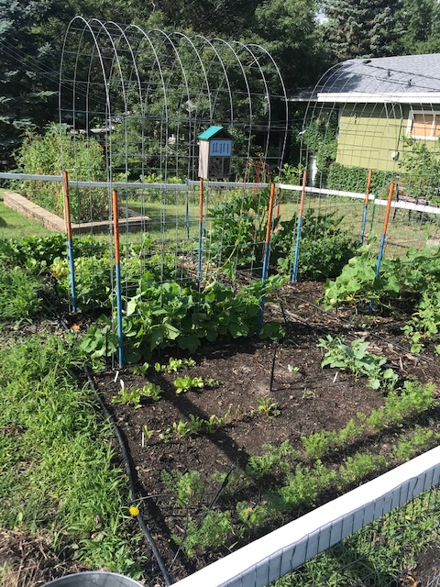
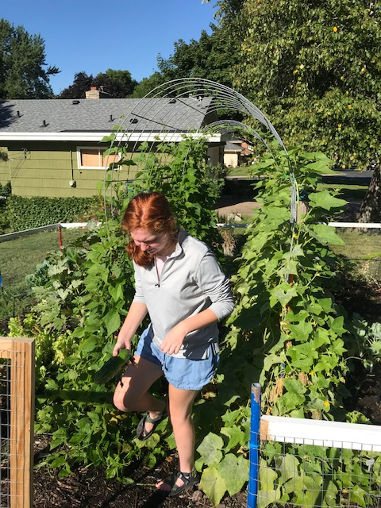
Growing local organic food to share
Notes:
We removed a portion of our turf to plant a vegetable garden where we grow food for the Little Kitchen food shelf.

Slide 10
Reducing Our Footprint
Notes:
We celebrate the work Nativity is doing to reduce our carbon footprint.

Slide 11
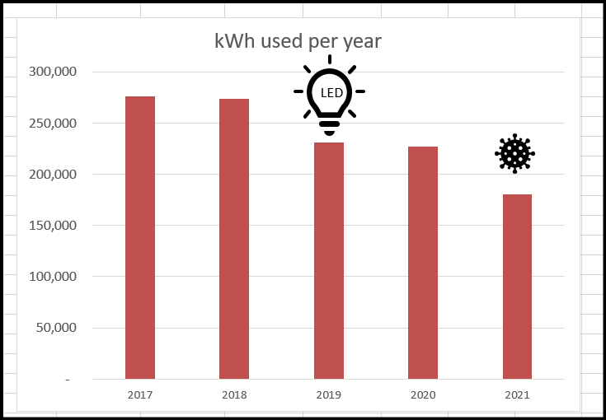
LED throughout our facility
Notes:
We installed LED lighting throughout the facility, which has reduced the amount of energy we consume.

Slide 12
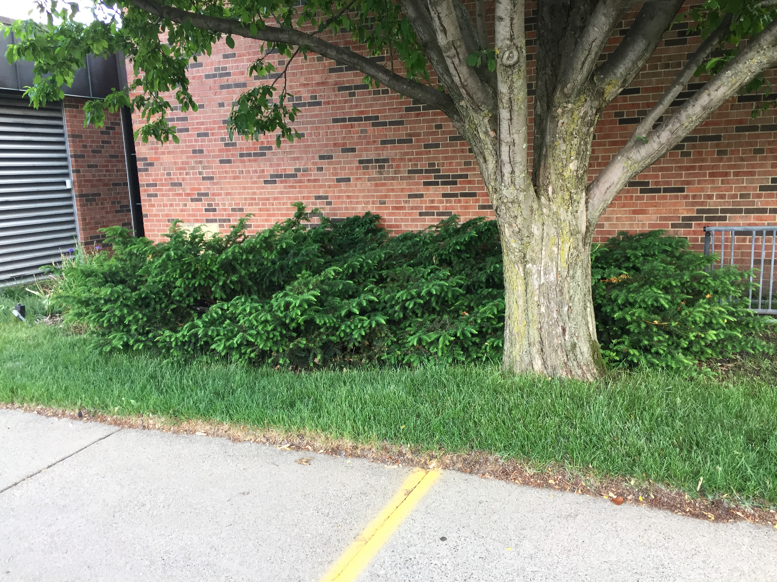
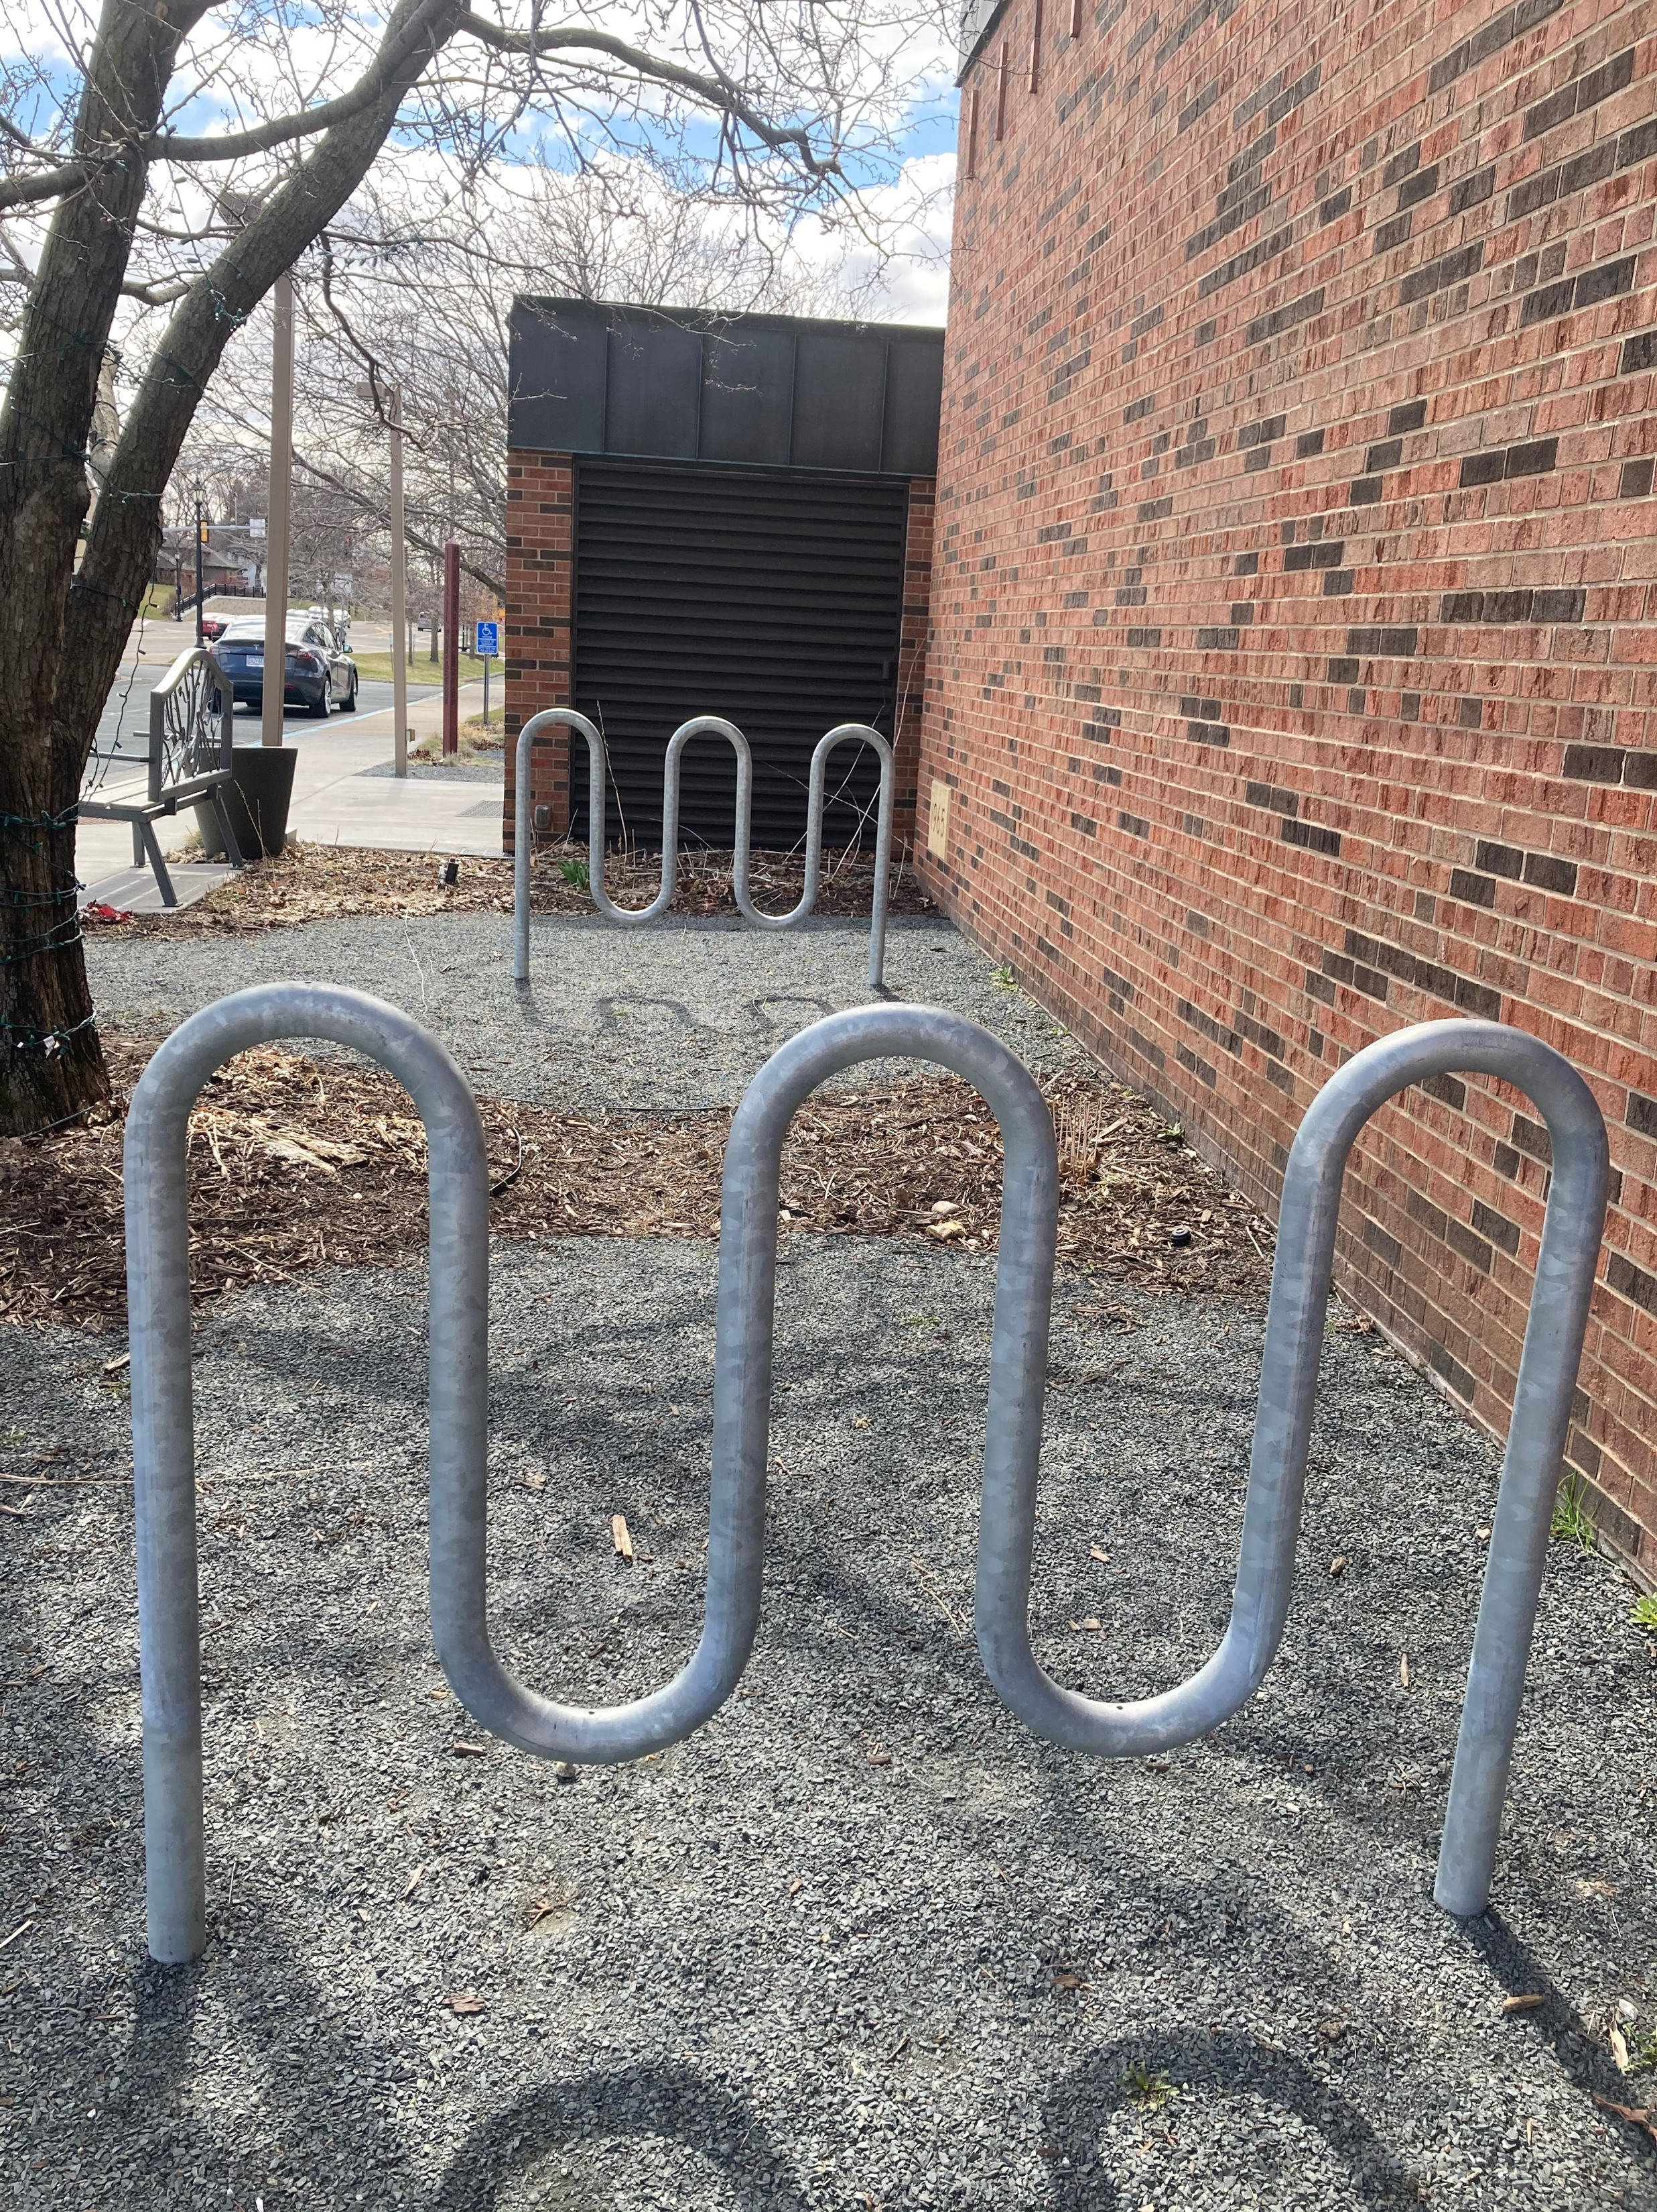
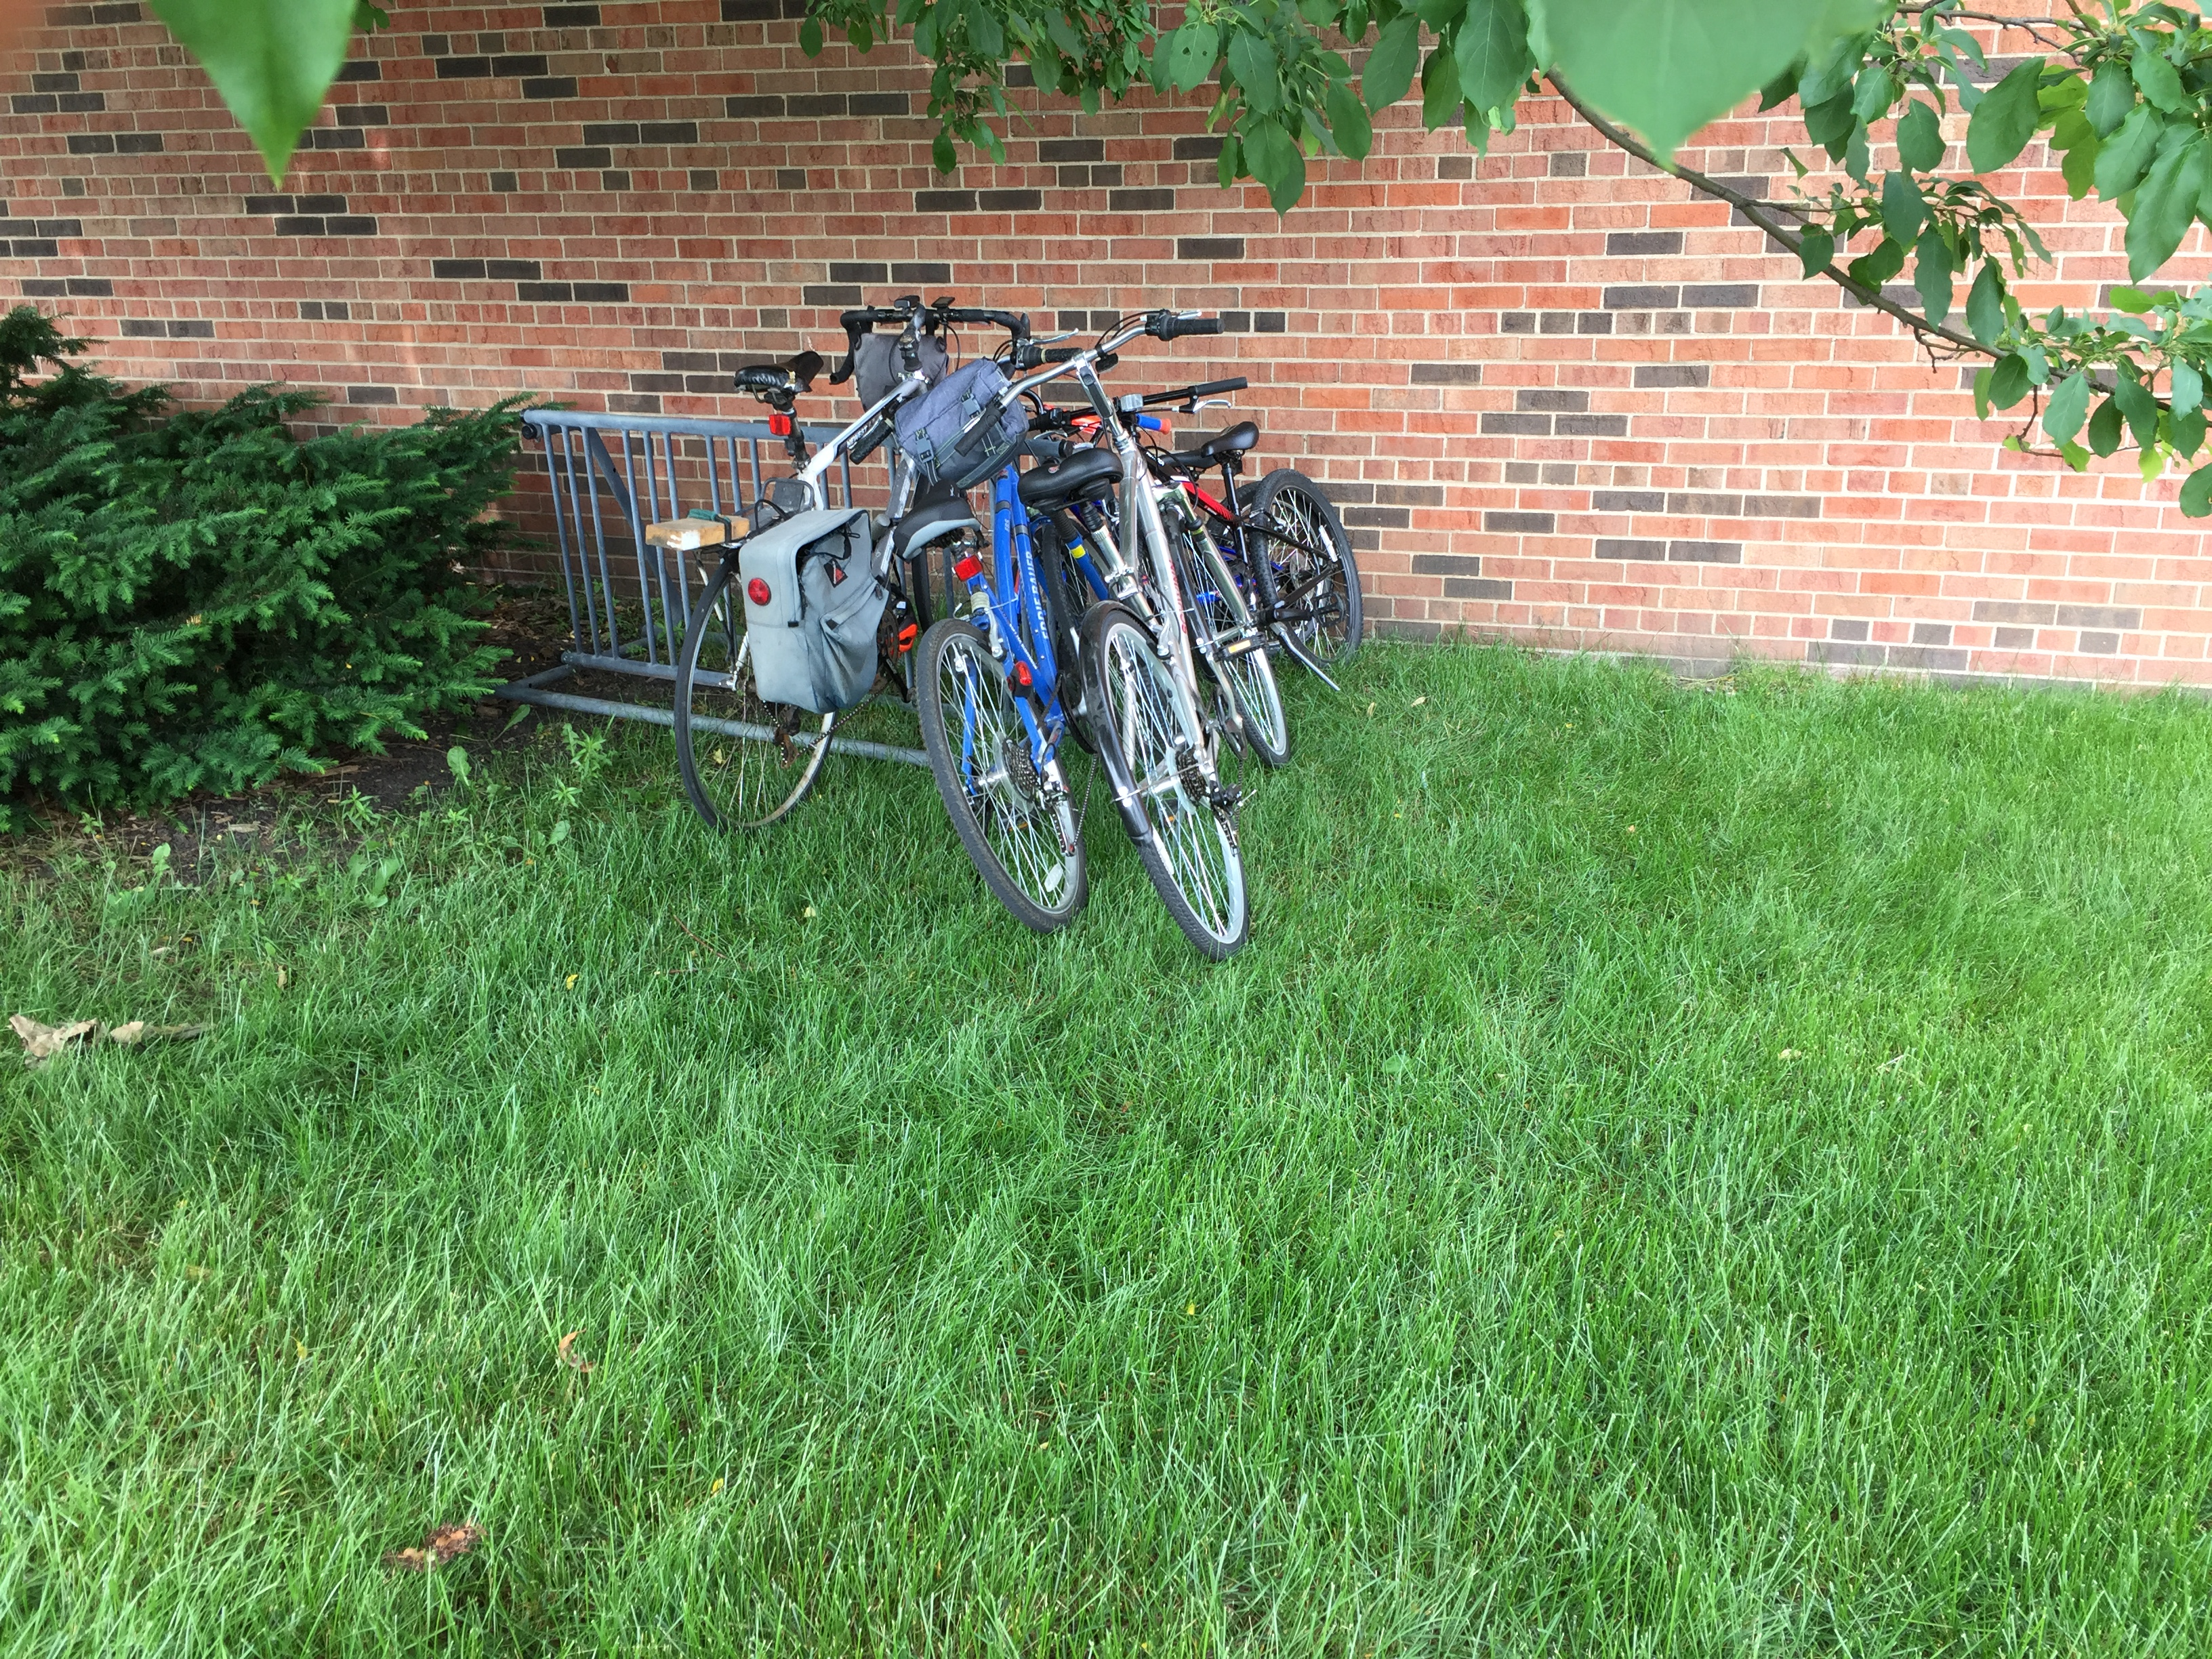
Expanding our biking capacity
Notes:
We have a growing number of members who bike to church and we have expanded our bike rack capacity near the east and west side entrances.

Slide 13
Reducing Our Runoff
Notes:
We celebrate the work Nativity is doing to reduce the pollutants that runoff our property.

Slide 14
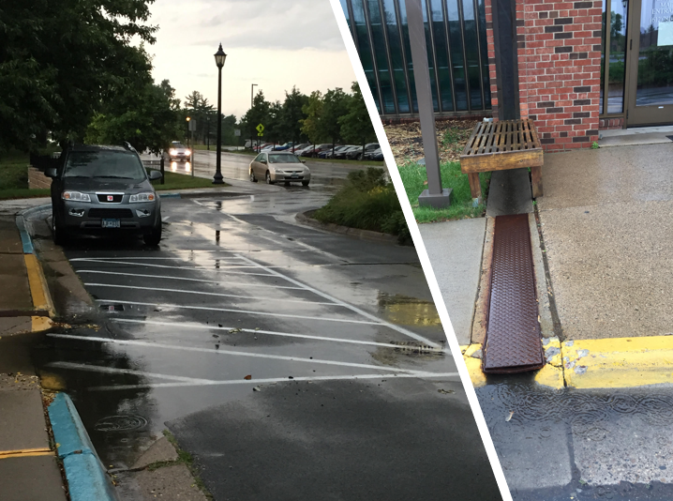
Notes:
The stormwater that collects and flows off our property carries pollutants from city streets to the Mississippi river.

Slide 15
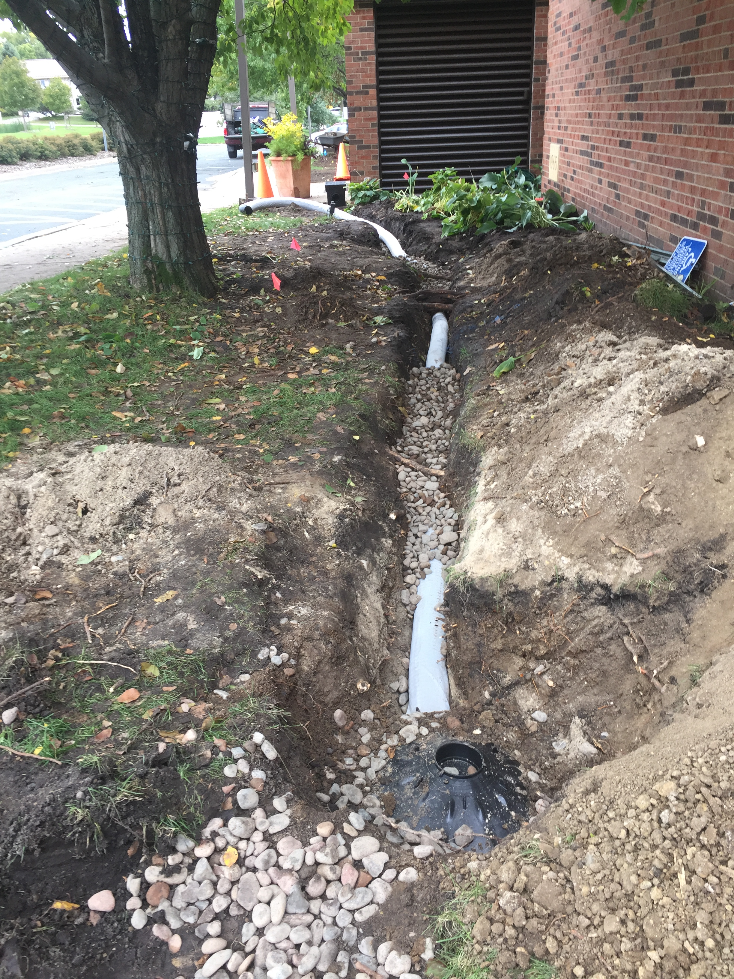
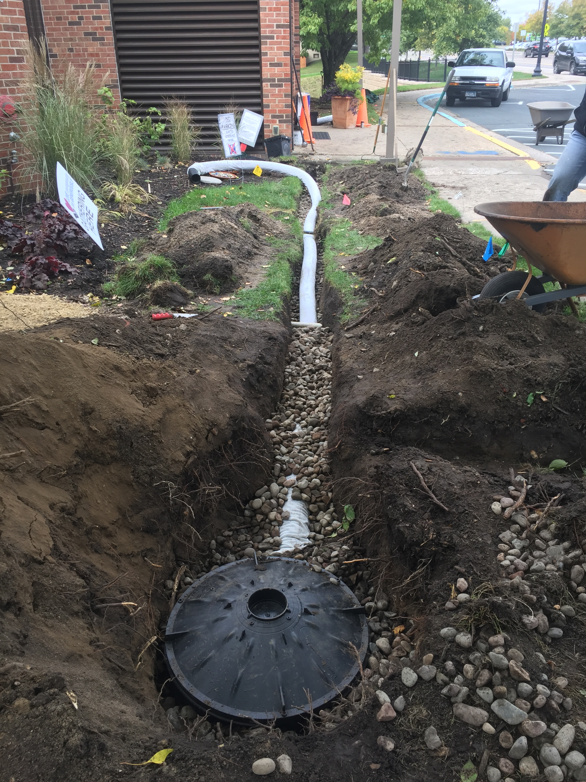
Notes:
We installed 100-gallon reservoirs on both sides of the front entrance to capture rainwater from our rooftop and keep it on site where it filters through the soil and replenishes water reserves here.

Slide 16
Reducing Our Waste
Notes:
We celebrate the work Nativity is doing to reduce the amount of waste we create.

Slide 17
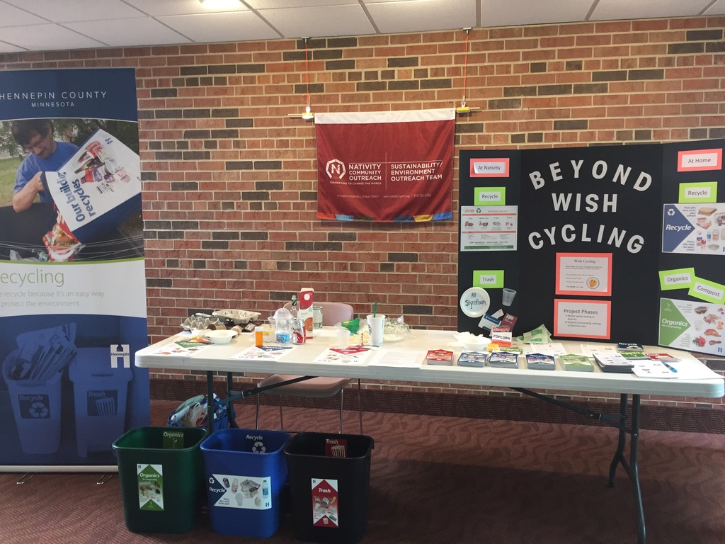
Beyond Wish Cycling
Notes:
In 2019 we sponsored a recycling campaign to improve the amount of waste we recycle.
We placed new recycle bins in the same areas we have trash bins.

Slide 18
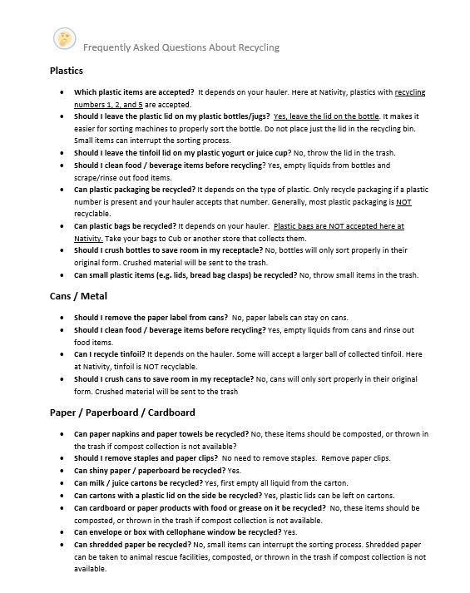
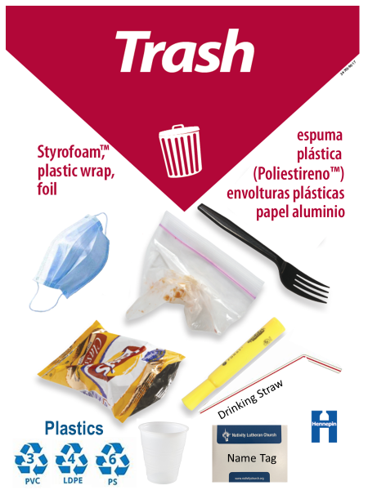
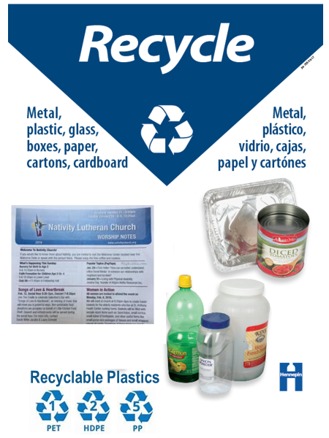
Clearer Signs & Better Information
Notes:
We posted clear signage above Recycling and Trash bins
along with answers to Frequently Asked Questions about what items can be recycled

Slide 19
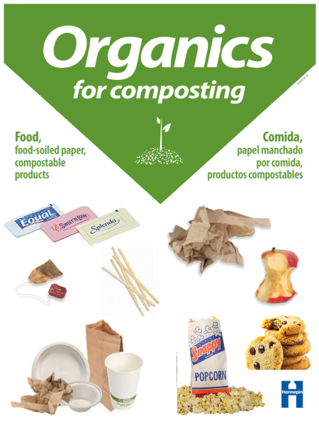
Nativity is Now Composting Food Waste!
Food waste and paper products are now recycled throughout our facility
Notes:
We are excited to announce that we recently installed compost collection bins throughout the entire building

Slide 20
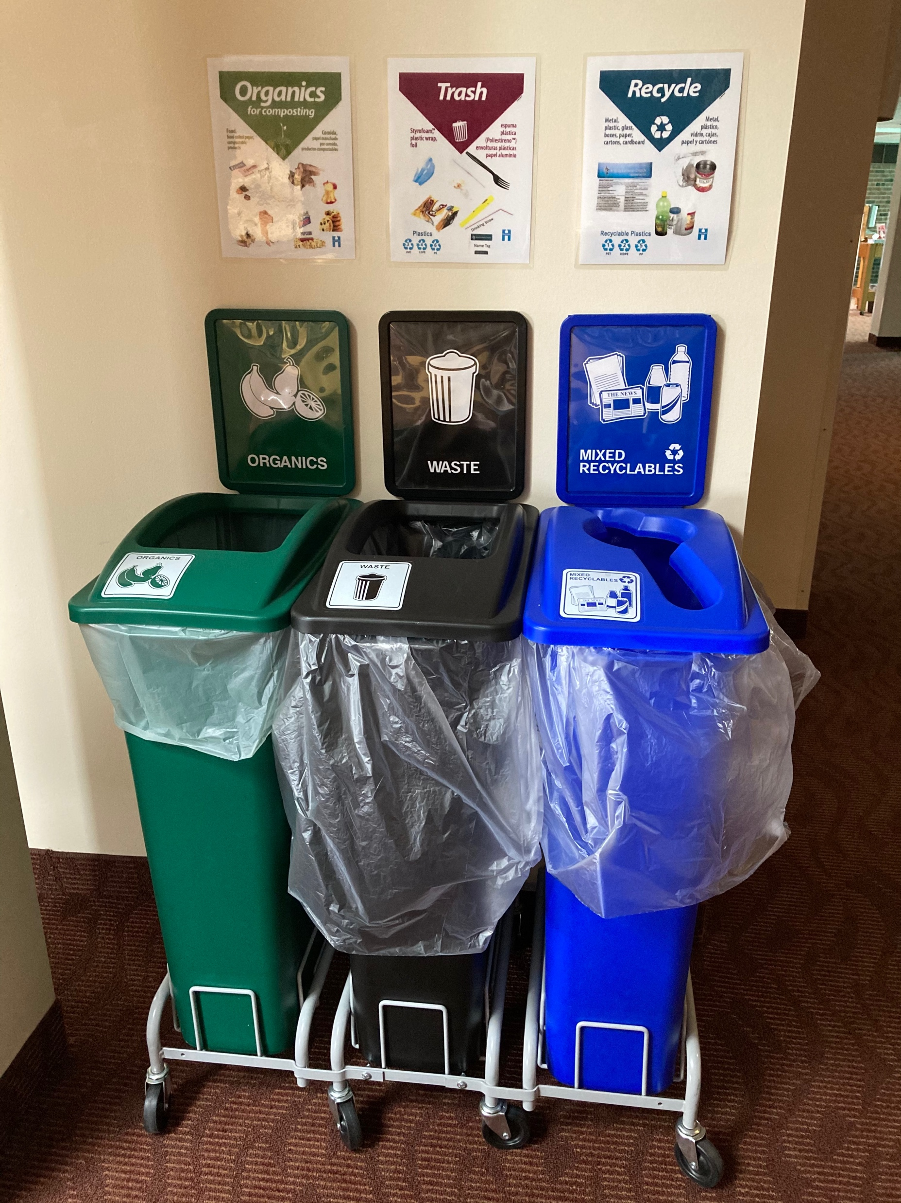
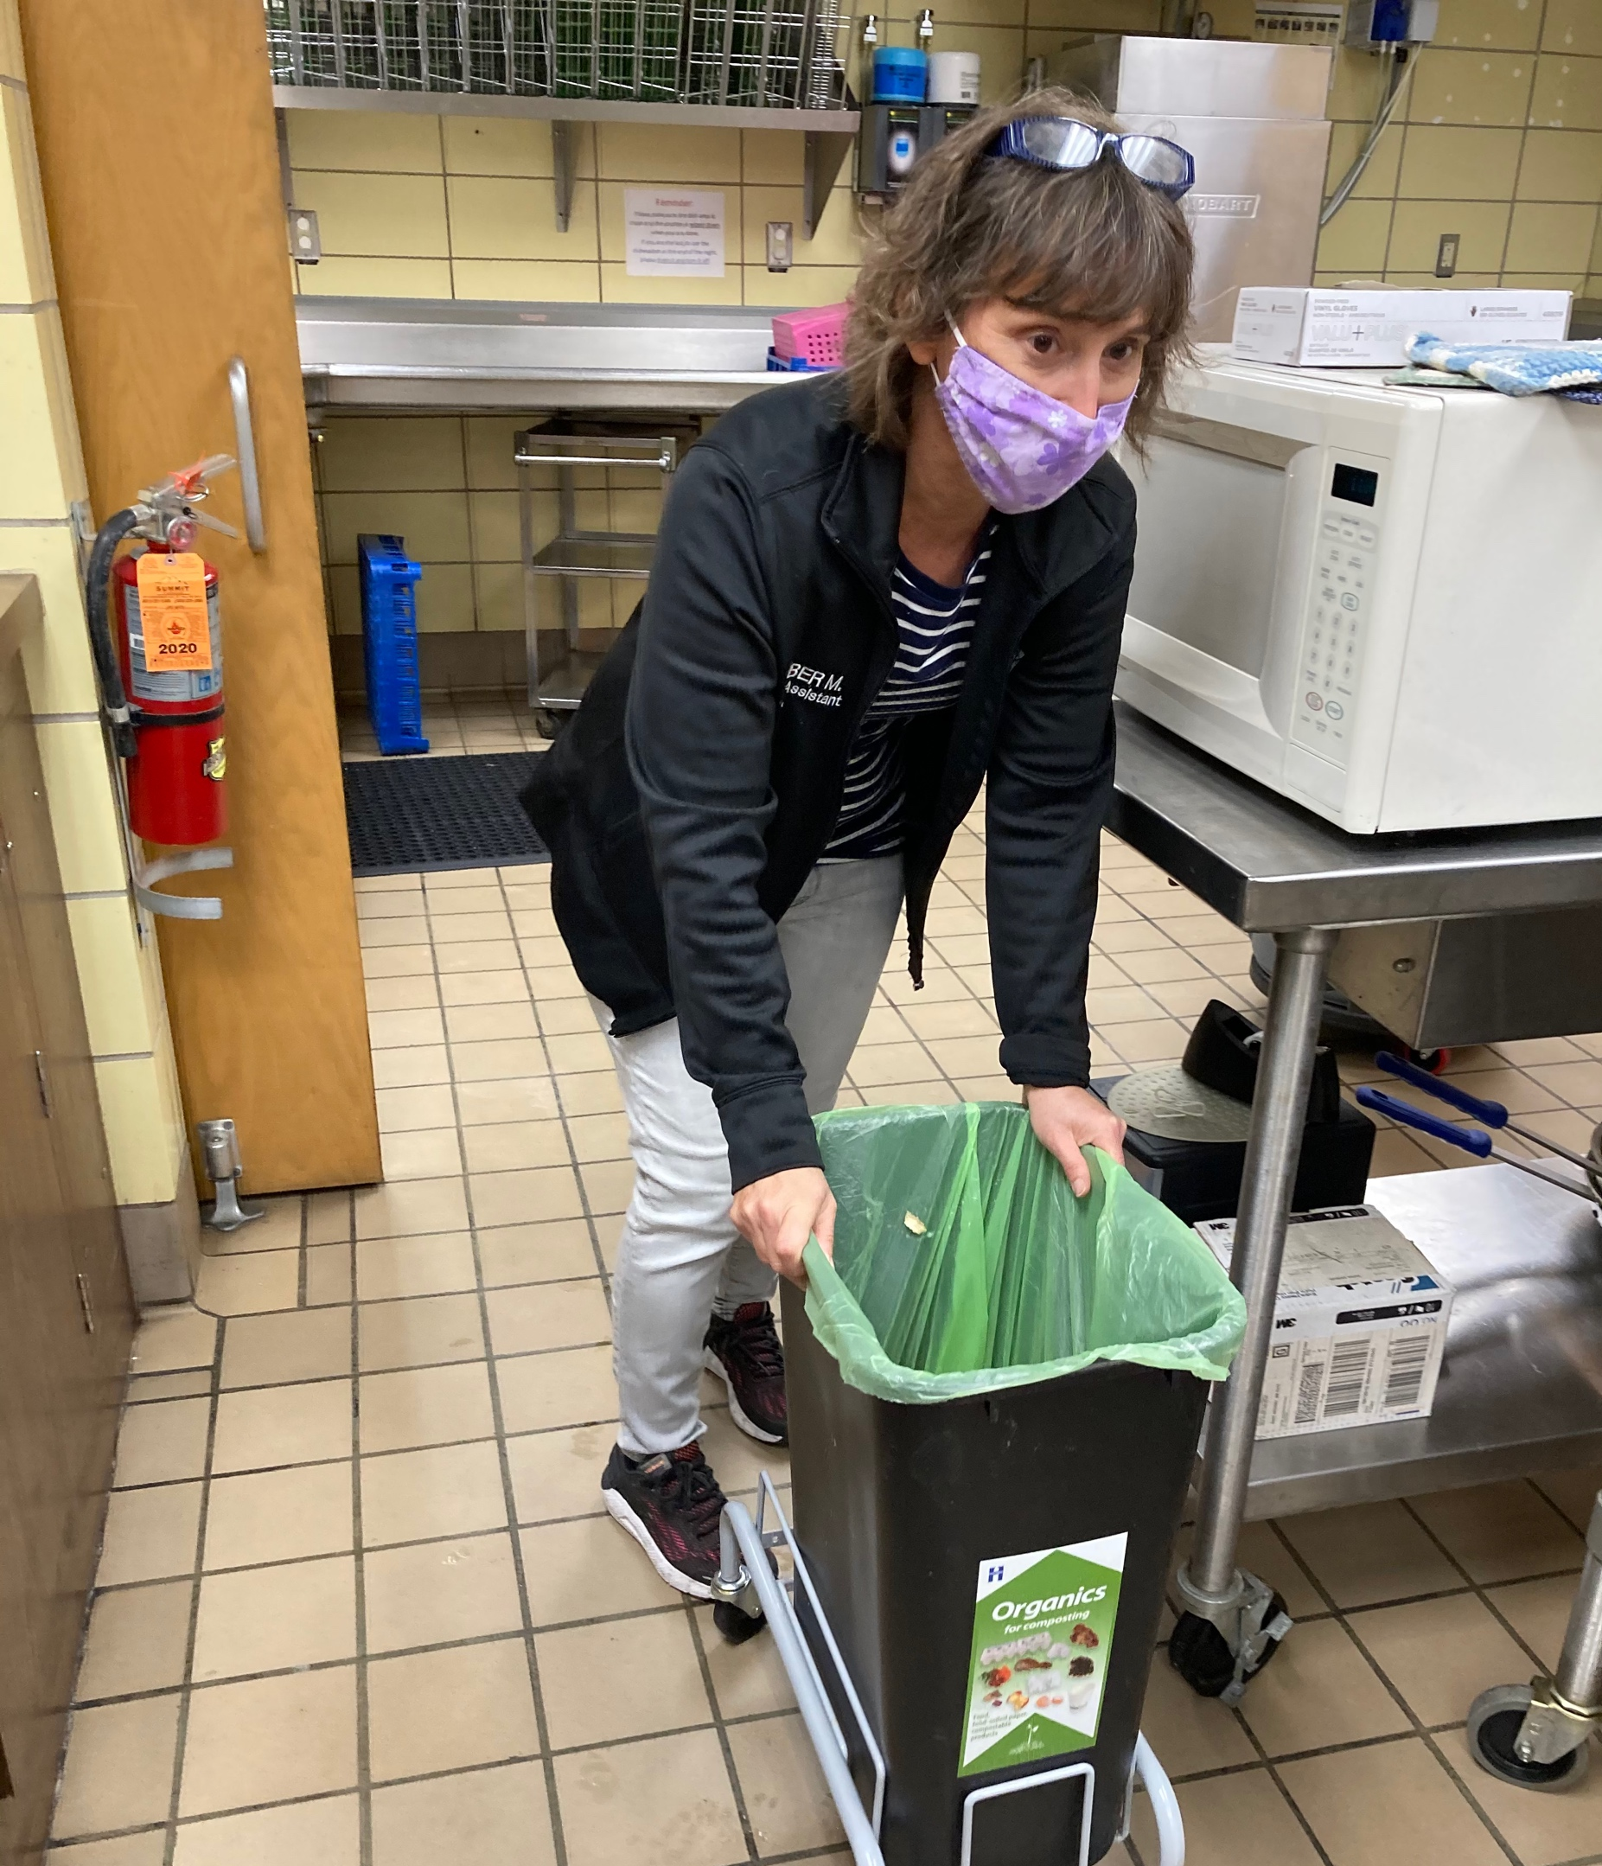
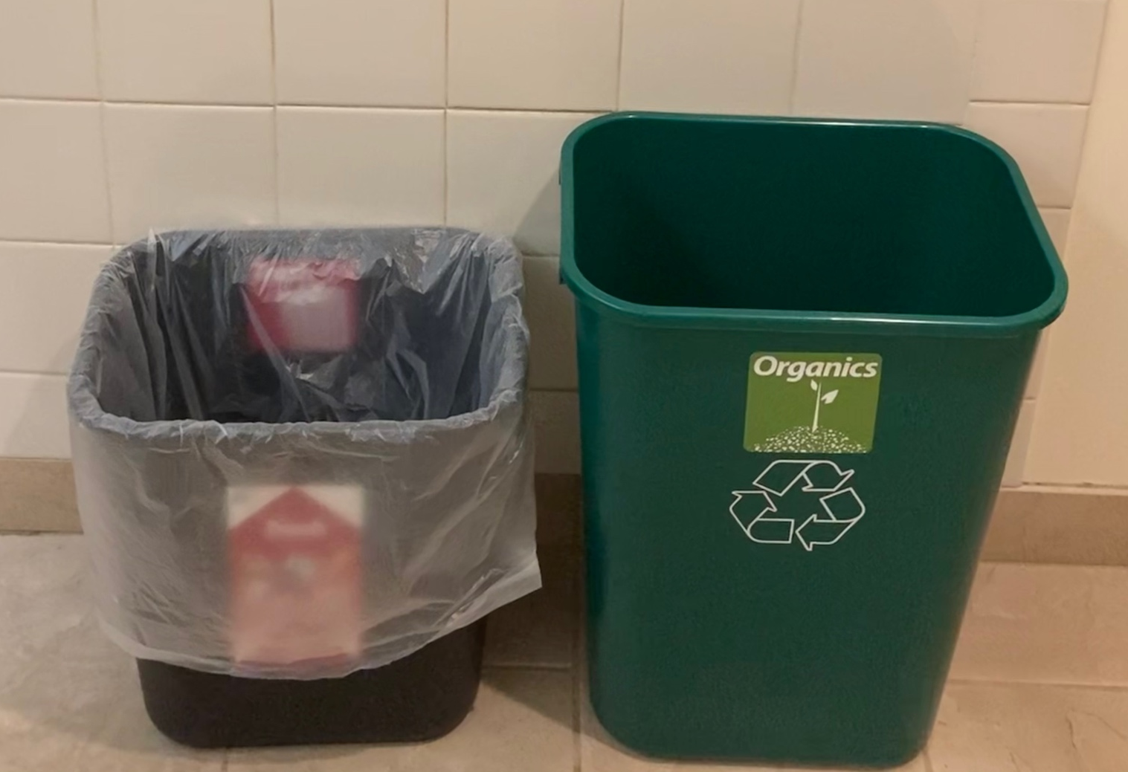
Notes:
When you return to church, you’ll notice compost bins in the kitchens, in the Commons, and in the restrooms.

Slide 21
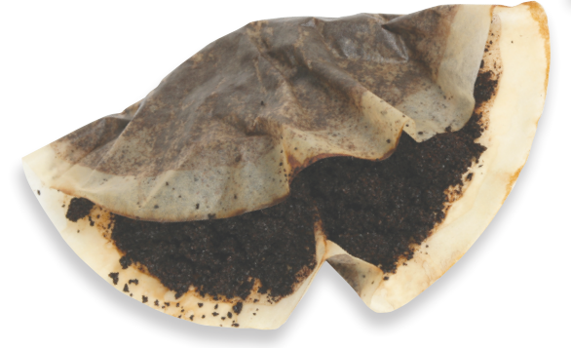
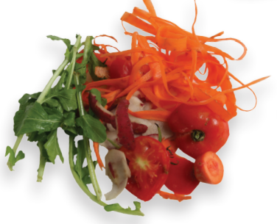
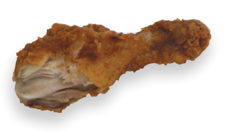
Composting in the Kitchen
Notes:
Composting in the Kitchen, means that all food scraps, coffee grounds and coffee filters should now be composted.

Slide 22
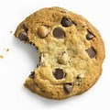
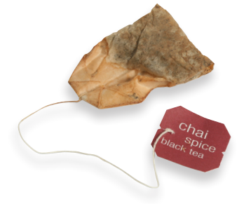

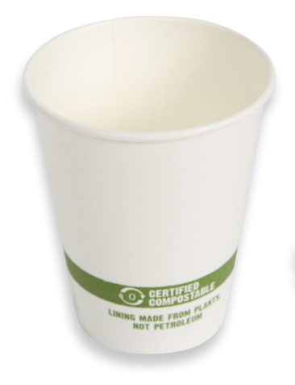
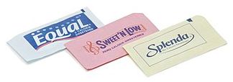
Composting in the Commons
Notes:
Composting in the Commons means that all food and compostable products should now go in compost bin. Popcorn, cookies, food, tea bags, napkins, and non-waxy paper products can all be composted.

Slide 23
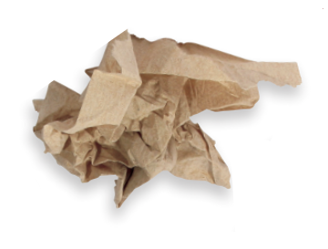
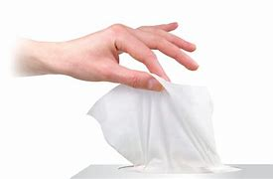
Composting in the Restroom
Tissue
Paper Towel
Notes:
Composting in the restrooms means that all tissues and paper towels should be composted. All other products should be thrown in the trash.

Slide 24
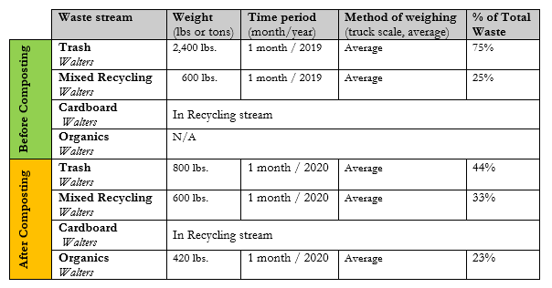
Waste reduction of 23%
Recycling increase of 8%
Notes:
We implemented composting at Nativity Child andFamily Center in September and since that time, we have diverted 23% of our waste to a composting facility. Not only does this reduce the amount of waste we send to landfills, but it also helps reduce our carbon footprint. When food decomposes in a landfill, it releases methane gas which contributes to global warming. When food waste is composted, it breaks down aerobically, without releasing methane gas.

Slide 25
How Can I Get Involved?
Contact Kyle Soderberg
kyle@nativitychurch.org
612-388-7135
Notes:
If you would like to join us in working on environmental stewardship here at Nativity, contact Kyle Soderberg at kyle@nativitychurch.org, or call 612-388-7135.

